Slide 1

UNIT-3
SAMPLING TECHNIQUES
Dr. Basavaraj S.Kudachimath
Management Studies
Visvesvaraya Technological University Belagavi

Slide 2
Discussion Points
Sampling: Concepts,
Types of Sampling,
Probability Sampling: simple random sampling,
systematic sampling, stratified random sampling, cluster sampling,
Non Probability Sampling: convenience sampling- judgmental sampling, snowball sampling, quota
sampling, Errors in sampling.

Slide 3

What is Samling?
Procedure by which some members of a given population are selected as representatives of the entire population.

Slide 4
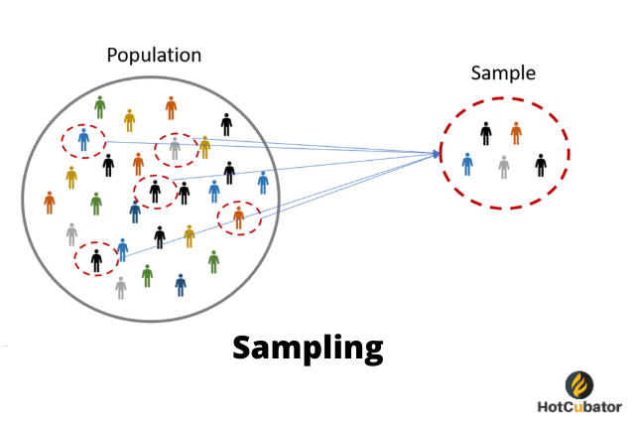
PURPOSE OF SAMPLING
To gather data about the population in order to make an inference that can be generalized to the population.
POPULATION
INFERENCE
SAMPLE

Slide 5

Process Of Sampling
Define the Population
Develop Sampling Frame
Select a Sampling Method
Determine Sample Size
Execute the Sampling Process

Slide 6
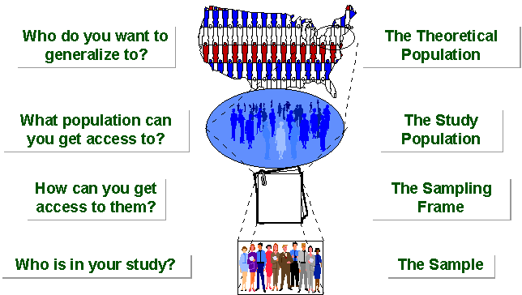

Slide 7
SAMPLING…….
STUDY POPULATION
SAMPLE
TARGET POPULATION

Slide 8
Types of Samples
I. Probability Samples
Simple random sample
  Systematic random sample
  Stratified random sample
  Cluster sample
  Multistage sample
  II. Non-Probability Samples
  Convenience sample
  Purposive sample
  Quota
  Snow ball sampling
Notes:
Two general approaches to sampling are used in social science research. With probability sampling, all elements (e.g., persons, households) in the population have some opportunity of being included in the sample, and the mathematical probability that any one of them will be selected can be calculated. With nonprobability sampling, in contrast, population elements are selected on the basis of their availability (e.g., because they volunteered) or because of the researcher's personal judgment that they are representative. The consequence is that an unknown portion of the population is excluded (e.g., those who did not volunteer). One of the most common types of nonprobability sample is called a convenience sample – not because such samples are necessarily easy to recruit, but because the researcher uses whatever individuals are available rather than selecting from the entire population.
Because some members of the population have no chance of being sampled, the extent to which a convenience sample – regardless of its size – actually represents the entire population cannot be known

Slide 9
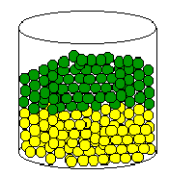
PROBABILITY SAMPLING
A probability sampling scheme is one in which every unit in the population has a chance (greater than zero) of being selected in the sample, and this probability can be accurately determined.

Slide 10
PROBABILITY SAMPLING…….
Types:
Simple Random Sampling,
Systematic Sampling,
Stratified Random Sampling,
Cluster Sampling
Multistage Sampling.

Slide 11

NON PROBABILITY SAMPLING
Any sampling method where some elements of population have no chance of selection (these are sometimes referred to as 'out of coverage'/'undercovered'), or where the probability of selection can't be accurately determined. It involves the selection of elements based on assumptions regarding the population of interest, which forms the criteria for selection. Hence, because the selection of elements is nonrandom, nonprobability sampling not allows the estimation of sampling errors..

Slide 12
NONPROBABILITY SAMPLING
Nonprobability Sampling includes:
Convenience Sampling,
Quota Sampling
Judgemental Purposive Sampling.
Snow ball Samling

Slide 13
TYPES OF PROBABILITY SAMPLING…….
Simple Random Sampling,
Systematic Sampling,
Stratified Random Sampling,
Cluster Sampling
Multistage Sampling.

Slide 14

1. SIMPLE RANDOM SAMPLING
Applicable when population is small, homogeneous & readily available
All subsets of the frame are given an equal probability. Each element of the frame thus has an equal probability of selection.
It provides for greatest number of possible samples. This is done by assigning a number to each unit in the sampling frame.
A table of random number or lottery system is used to determine which units are to be selected.

Slide 15
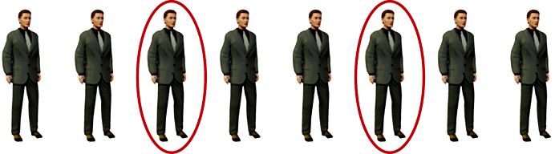
2. SYSTEMATIC SAMPLING
Systematic sampling relies on arranging the target population according to some ordering scheme and then selecting elements at regular intervals through that ordered list.

Slide 16
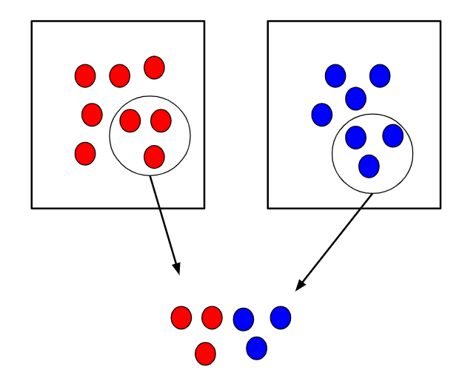
3. STRATIFIED SAMPLING
Where population embraces a number of distinct categories, the frame can be organized into separate "strata." Each stratum is then sampled as an independent sub-population, out of which individual elements can be randomly selected.
Every unit in a stratum has same chance of being selected.
Using same sampling fraction for all strata ensures proportionate representation in the sample.
Adequate representation of minority subgroups of interest can be ensured by stratification & varying sampling fraction between strata as required.

Slide 17
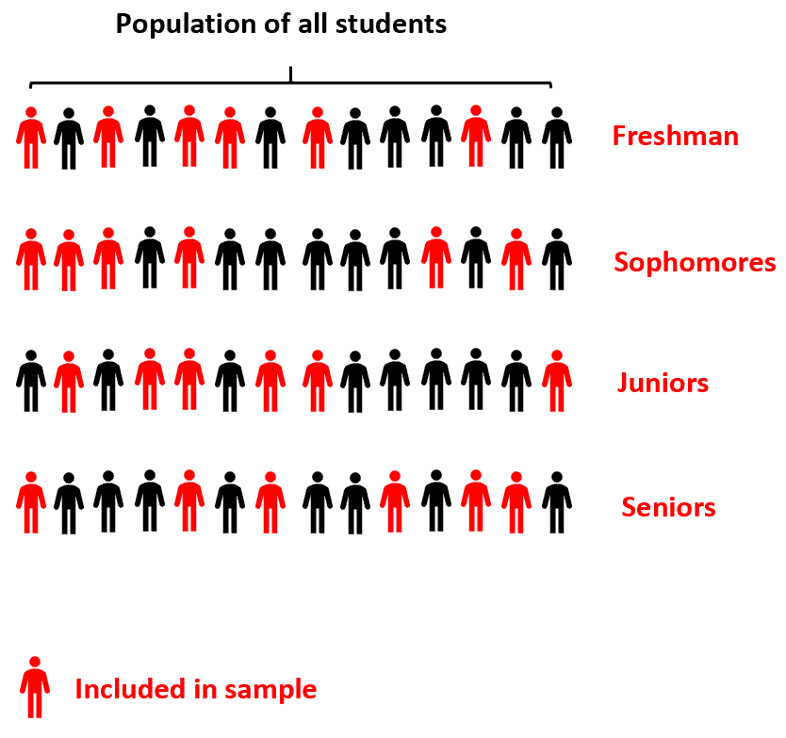
4. CLUSTER SAMPLING
First stage a sample of areas is chosen;
Second stage a sample of respondents within those areas is selected.
Population divided into clusters of homogeneous units, usually based on geographical contiguity.
Sampling units are groups rather than individuals.
A sample of such clusters is then selected.
All units from the selected clusters are studied.

Slide 18
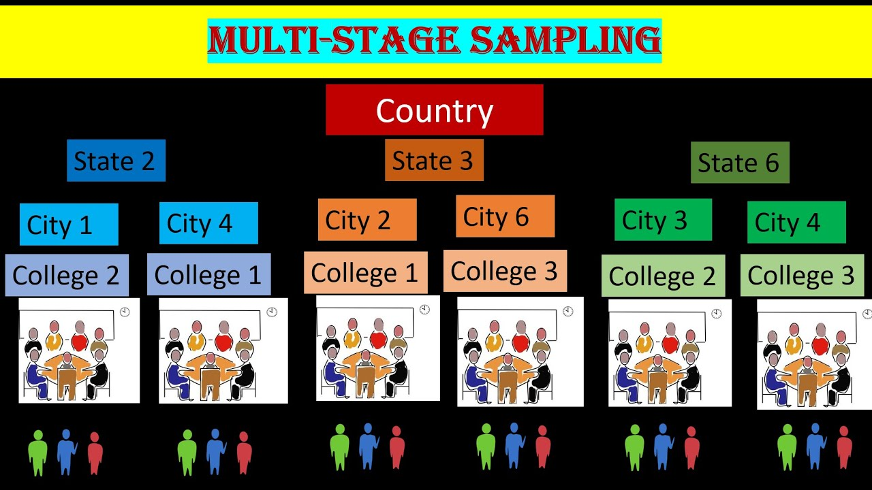
5. MULTISTAGE SAMPLING
Complex form of cluster sampling in which two or more levels of units
are embedded one in the other.
First stage, random number of districts chosen in all
states.
Followed by random number of talukas, villages.
Then third stage units will be houses.
All ultimate units (houses, for instance) selected at last step are surveyed.

Slide 19
TYPES OF NONPROBABILITY SAMPLING
Convenience Sampling,
Quota Sampling
Judgemental /Purposive Sampling.
Snow ball Samling

Slide 20
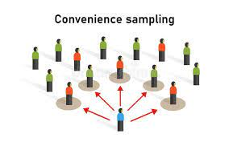
5. CONVENIENCE SAMPLING
Sometimes known as grab or opportunity sampling or accidental or haphazard sampling.
A type of nonprobability sampling which involves the sample being drawn from that part of the population which is close to hand. That is, readily available and convenient.
The researcher using such a sample cannot scientifically make generalizations about the total population from this sample because it would not be representative enough.

Slide 21
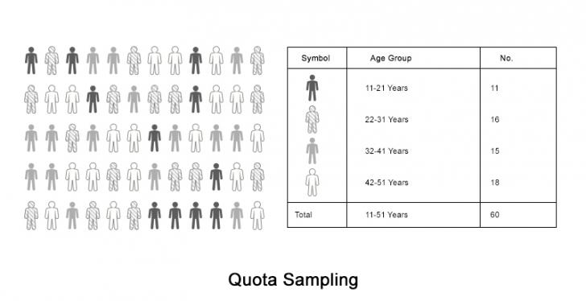
2. QUOTA SAMPLING
The population is first segmented into mutually exclusive sub-groups, just as in stratified sampling.
Then judgment used to select subjects or units from each segment based on a specified proportion.

Slide 22
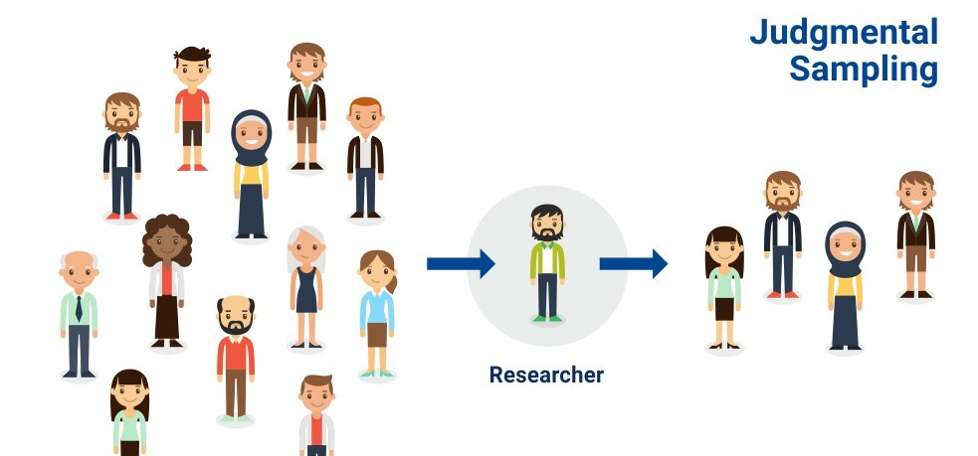
3. Judgmental sampling or Purposive sampling
The researcher chooses the sample based on who they think would be appropriate for the study. This is used primarily when there is a limited number of people that have expertise in the area being researched

Slide 23

4. Snowball sampling
Snowball sampling is finding the large samples with the help of small sample. It is used where potential participants are hard to find. It's called snowball sampling because (in theory) once you have the ball rolling, it picks up more “snow” along the way and becomes larger and larger.

Slide 24
Questions???

Slide 25
What sampling method do you recommend?
A study on undernourished five year old children in Jamboti Village in Belgaum district.
Investigating nutritional status of preschool children in Karnataka state.
Selecting maternity records for the study of previous abortions or duration of postnatal stay.
A study on impact of Covaccine protection against Covid-19 disease
Study of consumer behavior towards Big Bazaar in Belgaum.

Slide 26

Understanding Sampling Errors
Bridging the gap between sample and population — why the data we collect rarely tells the whole story.

Slide 27
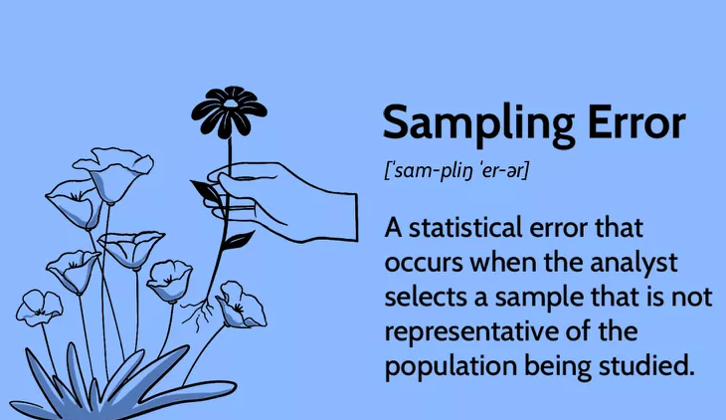
What is a Sampling Error?
A sampling error is the gap between what your sample tells you and what is actually true about the entire population.
It is the difference between a sample statistic (e.g., sample mean) and the true population parameter (e.g., population mean).
These errors are inherent in any study that uses a sample instead of a complete census — making them impossible to eliminate entirely, but possible to minimise.

Slide 28
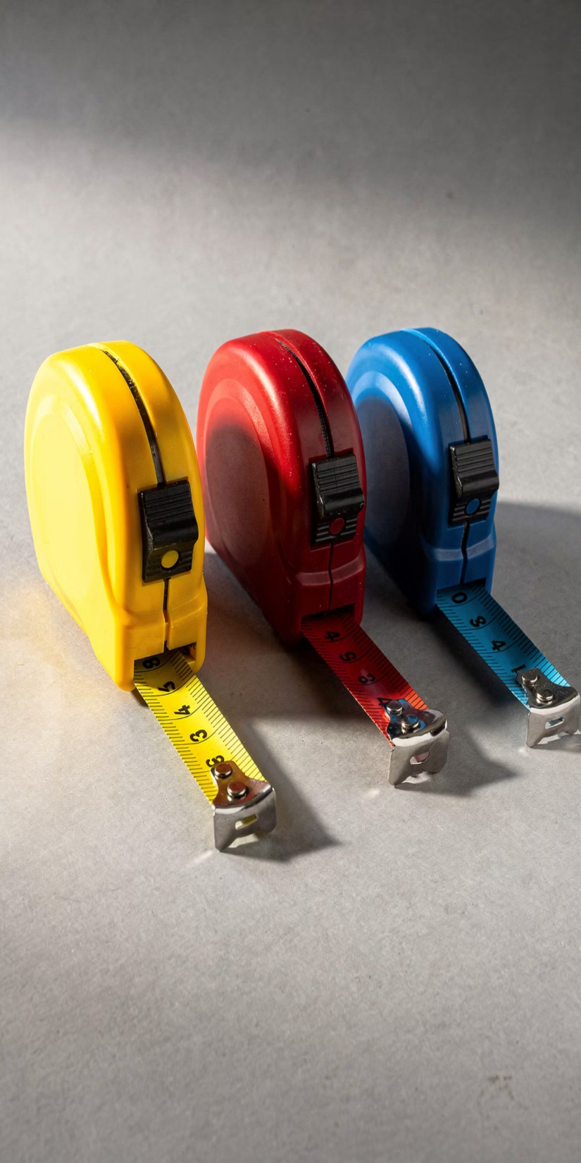
Types of Sampling Errors
Selection Bias
When the sampling method is not random, the sample systematically differs from the population.
Example: Surveying only smartphone users to understand general internet usage — excluding those without smartphones.
Sample Size Too Small
A sample that is too small may fail to capture the diversity
of the population.
Example: Estimating average city height by measuring only 10 people.
Disproportionate Representation
The sample's proportions of certain characteristics do not match the population's proportions.
Example: A consumer survey skewed heavily towards young adults when they are a minority in the real population.

Slide 29
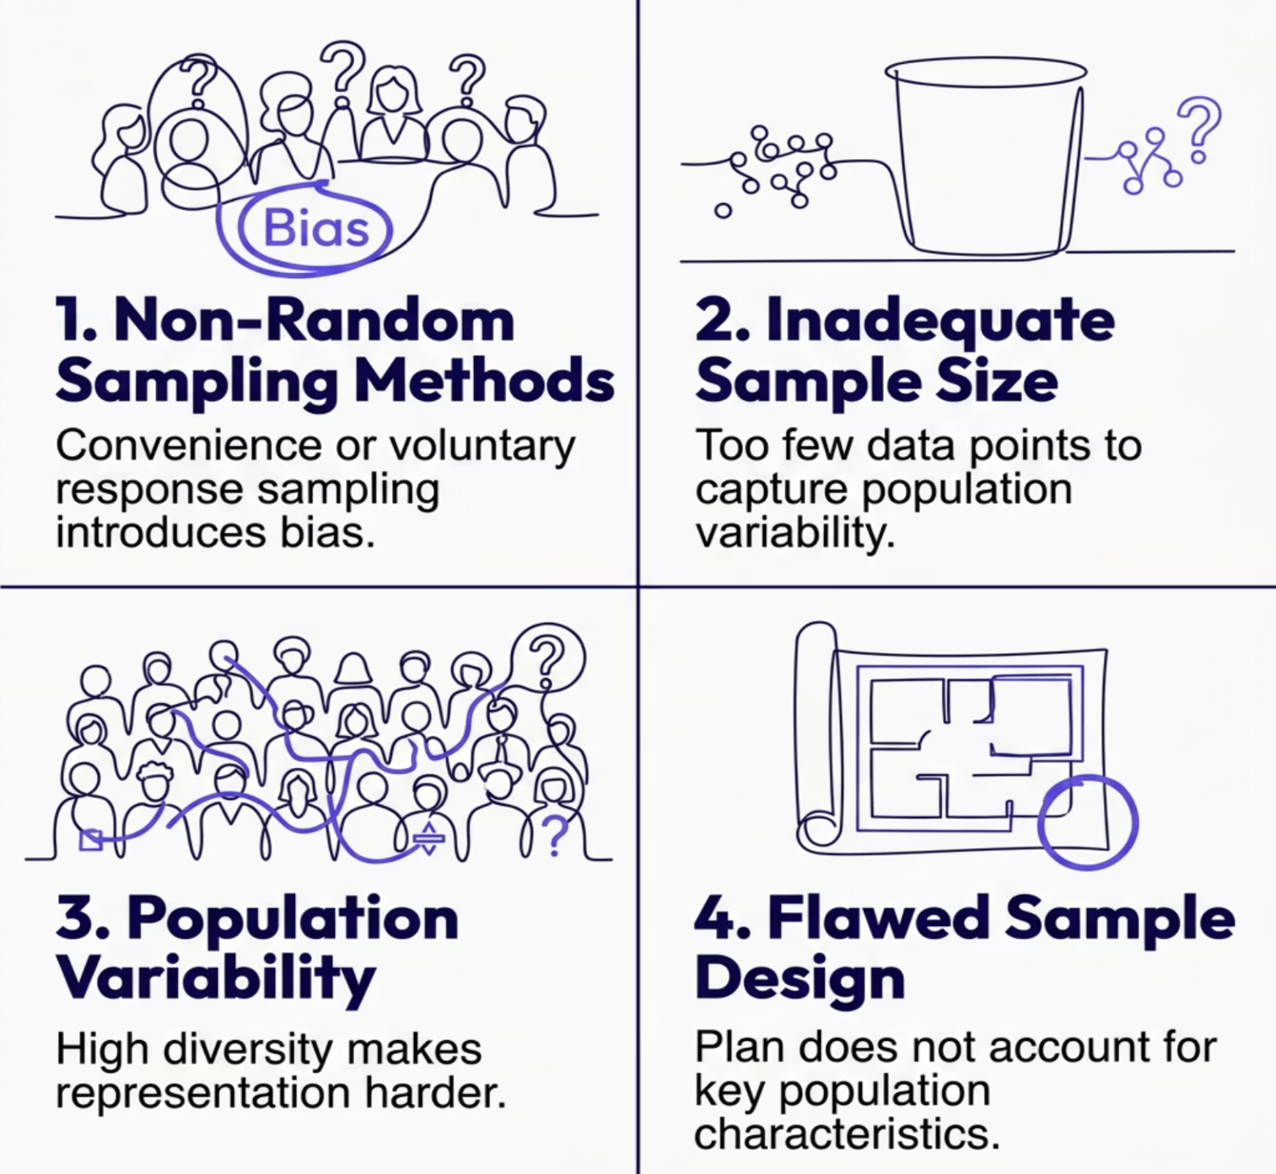
Causes of Sampling Errors

Slide 30


Real-World Examples of Sampling Errors
Political Polling
A pre-election poll that over-samples a particular demographic can inaccurately predict the election outcome — as seen in several high-profile electoral upsets.
Market Research
Surveying only existing customers to gauge interest in a new product misses the perspectives of potential new customer segments entirely.
Health Studies
A drug efficacy trial limited to one geographic region may not reflect how the treatment performs across diverse populations with different genetic or environmental profiles.

Slide 31
01
Minimising Sampling Errors
Increase Sample Size
Larger samples reduce sampling error and better reflect population variability.
While sampling errors can never be fully eliminated, following these principles drives your research towards greater accuracy and reliability.
02
Use Random Sampling Techniques
Apply simple random, stratified, or cluster
sampling to minimise bias.
03
Ensure Proportional Representation
Mirror the population's key demographic and characteristic proportions in your sample design.
04
Define the Target Population Clearly
Precisely identify who you are studying before selecting a single respondent.

Slide 32


